Slide 1
Events App:
DEV Week Assessment
Jeremy Aranguren, Nora Bonifas, Maria Gocal-Kappos, Linette Maliakal, and Janeen Soria

Slide 2
Structure
Using Apache Cordova
HTML, CSS, JavaScript
Cross-platform (main focus on Android)
Have a wider audience
Would not limit users from finding other people who are interested in an activity
Sensors
Geolocation: helps user find events and other users who are interested in the same activity based on their current location
Notes:
Maria - recap of what our app is, decided to use Cordova because some of us are familiar with HTML and CSS
Jeremy- last bullet point

Slide 3
Development Progress
Some functional navigational buttons appear on emulator
Buttons lead to intended screens/pages
Created files for the screens/pages of the app
Profile
Home/Events
Interests
Settings page→ Geolocation
Created horizontal navigation bar at the top of the screens
Currently deciding on the colors
Notes:
Nora- adding we are trying really hard not to get caught up in design, because we want to achieve a certain level of functionality first. We know what we want our app to look like, but we don’t have a finished functional program to make look good quite yet. We are getting there tho!

Slide 4
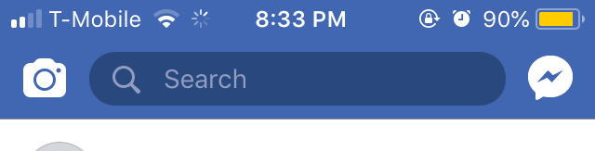
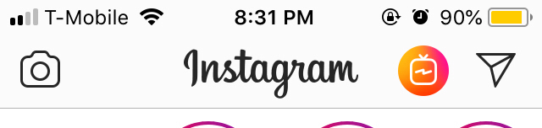
Research
Sticky navigation bar with icons/buttons over it
Easy, consistent access
Grouping, easy to identify
Notes:
Janeen In our first sketch, we only had the icons and title at the top, they didn’t look grouped together

Slide 5
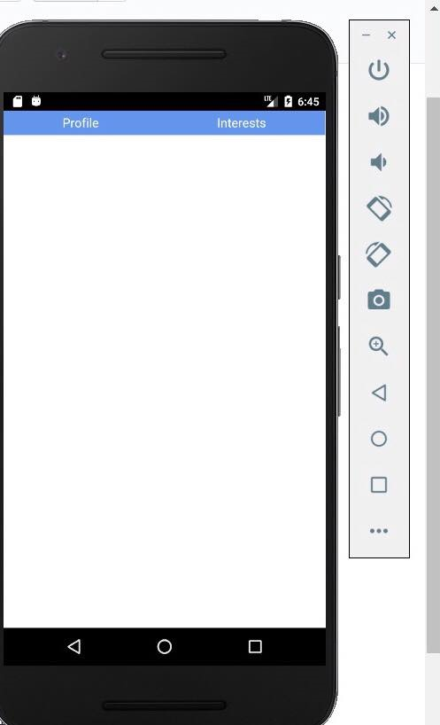
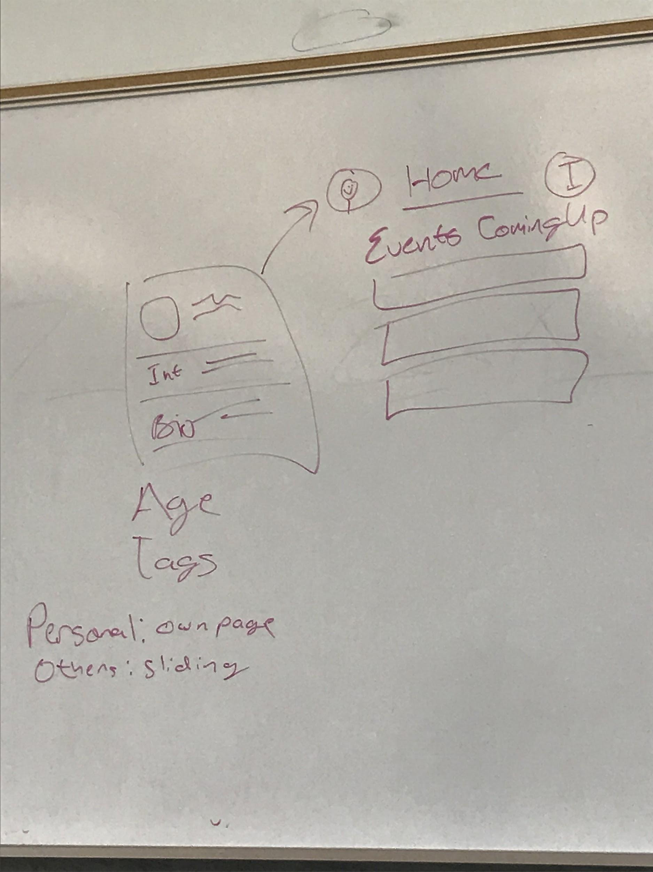

Slide 6
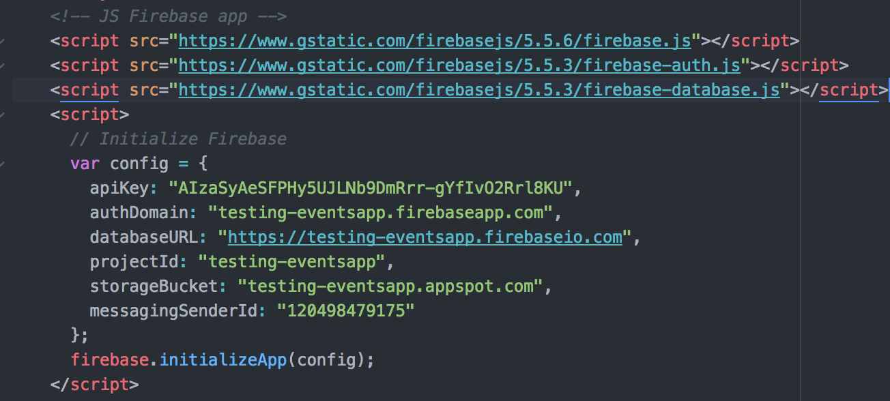
Currently Developing
Firebase storage
User verification through Firebase
Getting database started up with imported JSON files once made for events
Improving geolocation
Implementation of Flexbox for consistent UI
Notes:
Linette

Slide 7
Demo
Notes:
Master branch (buttons/access to other screens, geolocation)
Janeen branch (navigation bar/access to other screens)

